Slide 1
PROJECT ON
WEATHER APPLICATION
PROJECT GUIDE:
SOUMYA BHATTACHARYA
TEAM MEMBER DETAILS :
NAME | ROLL NO.
Suryakanta Mazumdar | 430416010057
Partha Ghosh | 430416010026
Sanchari Roy | 430416020036
Indrani Bardhan | 430416020018
Sarbani Mukherjee | 430416010038

Slide 2
AUTHENTICATION
I Suryakanta Mazumder hereby declare that Weather application has been carried out in the practical laboratory of Department of Information Technology in NIT under the guidance of Sir Soumya Bhattachraya I also declare this project work has not been submitted anywhere for fulfillment of a course of study to the best of our knowledge.
------------------------------------- Mr...................
( IT Dept.)

Slide 3
ACKNOWLEDGEMENT
First I owe to express our almighty “GOD” for his inherent inspirationand being with us through out this venture.No words can contain and convey my intense feeling of dedication,earnestness and gratitude of my learned guide .........whose perpetual guidance,encouragement and willingness to help promoted me to steer clear through this project. I would like to express my humble regards to him for providing us with full support, cooperation and his invaluable time with us. We got a very nicelearning experience and learnt a lot under his guidance.
We humbly express our deep sense of guidance to Mr Soumya Bhattarchrya for helping us by showing simplified way out during many difficult situations which we had faced during the preparation of this project and it also not out of phase to thank some of our good friends who shared their knowledge in some of the tough situations with us . We render our deep sense of guidance to our beloved parents for their constant encouragement,timely assistance, dedication, inspiration, moral support and silence presence throughoutthe work.
THANK ING YOU ALL
Department of Information Technology

Slide 4
In the Project Department Of Information Technology of “WEATHER APP” we have arranged the piece of code into three different sections by usingHTML, CSS and JAVASCRIPT in a very simplified manner. The main objective of this Project is to detect
the weather forecasts of any cities instantly through this application.
Forecasts are givenfor the present and the following day, textually and in picture format. User friendliness is the aim of the project. It is hoped that this project will be useful for the user.
DEPARTMENT OF INFORMATION TECHNOLOGY

Slide 5
Table Contnets :
1. Project Overview Statement | PAGE NO. 6
2.Needs OF Weather App | 7
3.1.Product overview | 7
4.Feasibilty study | 7
5.Economical Feasiblity | 8
6.Operational Feasibilty | 8
7.Technical Feasiblilty | 8
8.Requirements | 9
9.Activity Diagram | 11
10.Class Diagram | 11
11.Use Case Diagram | 11
12.Data Flow Diagram | 12
13.Gantt Chart | 13
14.Gantt Chart Diagram | 14
15.User Interface | 16
16.Coding and Testing | 18
17.Benifits
18.Future Enhancements
19.Conclusion

Slide 6
Project Overview Statement (POS) :
Project Title | Weather Application
Project leader | Suryakanta Mazumder
Department | Information Technology
Project ID
Needs Of Weather Application :--
To plan journey ahead accordingly.
To know when its going to rain or going to be cloudy.
A person travelling in a bus/train etc. might need to know the weather of destination city.

Slide 7
Sometimes travellers may need to know more details about the weather like
visibility, fog, humidity etc.
To plan meetings/commute timings

Slide 8
Product Overview:-- 1. Headline at the top 2. Background image under the headline 3. The current local temperature will be displayed in Celsius Along with the local temperature, local time and weather description will also be displayed. ➢ A search box will be present for searching the weather for other locations . 4.The page will ask for access to the user’s location on load to update weather information

Slide 9
Feasibilty study :-
Feasibility study is an important outcome of preliminary investigation, which is determination
of whether the request is feasible or not.During our preliminary investigation at college (Department of Science) we examine that theentire affaire concerned with the “Request” is to develop a new project. After getting information we check that the information is economical, technical and operationally feasible or not.
The proposed system is reviewed considering three feasibility studies, which are as follows,
Technical Feasibility
2.Operational Feasibility.
3.Economical Feasibility.
¬

Slide 10
ECONOMICAL FEASIBILITY
The hardware/software setup required is that the proposed system can be easily run on any dual core computer and as the software used to build system in windows98/2000/XP/ or we can build this in Linux/GNU also.So it does not cost high.
OPERATIONAL FEASIBILITY
One of the objectives of developing and userfriendly application apart from speeding of the operation is that users do not face any problem while making any plans depending on the weather.

Slide 11
TECHNICAL FEASIBILITY
Though, there is no equipment in existing system, essential to implementation new computerized system but are not away from college access. The hardware required is (i.e. P.C.) and software Code editors for write code are available at many developers point .

Slide 12
REQUIREMENTS
HARDWARE & SOFTWARE REQUIREMENTS
The Hardware and Software requirements are as follows:
Hardware Specifications:
PROCESSOR : Cortex A7
RAM : +512MB
Software Requirements
1.Internet Browser
2.Internet Data

Slide 13

Activity Diagram
Display Error Message
Enter city
Search location
Check for city
No
Unknown place
Yes
Display weather
Also forcast weather

Slide 14









class diagram
Application isual UI touch 8
+Request info.(
User
+have browser
+have data pack
<<Interface>> JSON object
+Request Id
+city name
Use case diagram
Enter City
JSON
response
Display location
Response Interpretation
Fetch icon
Temperature unit
forecast

Slide 15
DFD
Client
Server
Search Weather
Receive String
Lexical Analisys
Text input
Start App
Morphological Analisys
HTTP Post Request
Syntactic Analisys
Launch Action
Semantic Analisys
End App
Recognize User,s Objective

Slide 16
GANTT CHART
A gantt chart is a horizontal bar chart developed as a production control tool in 1917 by Henry.L.Gantt an American engineer and social scientist.Frequently used in project management.A gantt chart provides a graphical illustration of a schedule that helps to plan,coordinate,and track specific tasks in a project.

Slide 17
Gantt Chart
90
3
80
3.78
70
4.12
60
3.33
50
2.1
40
4.5
30
3.5
20
2.5
10
4.3
Series 1 Column2 Column1

Slide 18
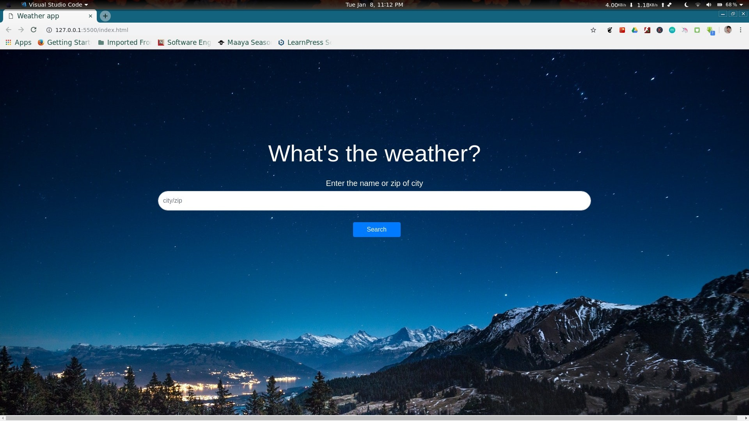
User Interface

Slide 19
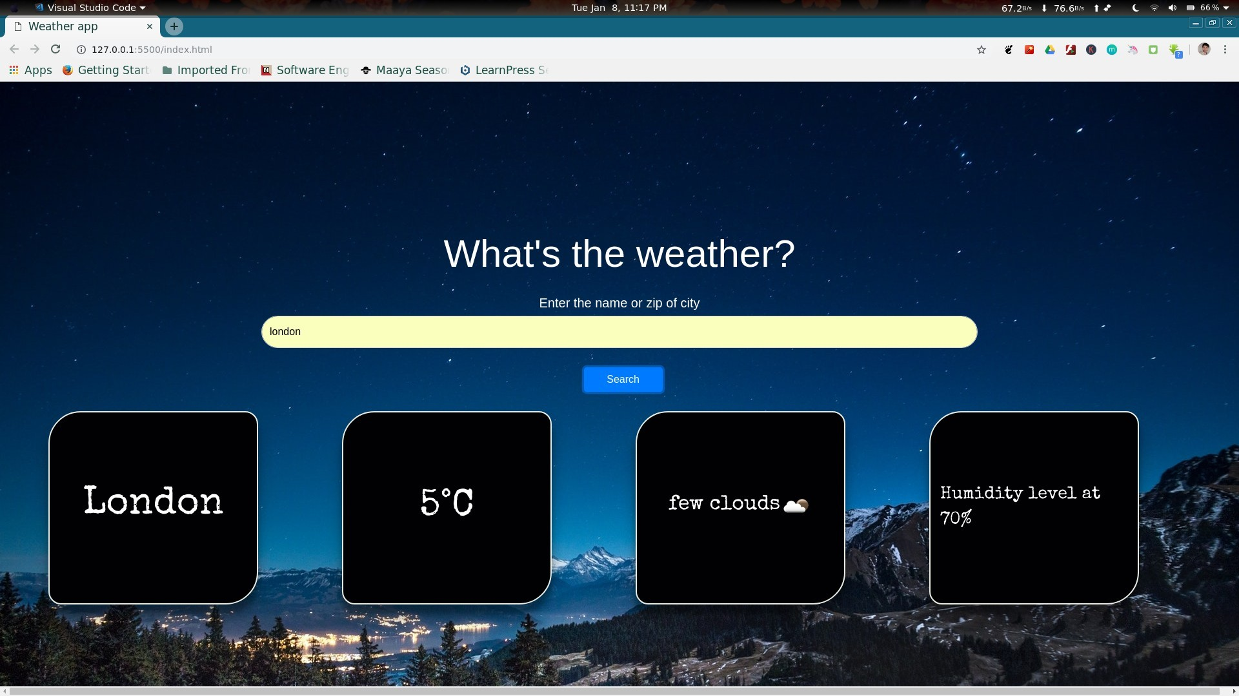

Slide 20
BENEFITS
Improve Operational Efficiency
Useful For Various Weather Operations
Less Efforts In Managing Farming Operations
Easy Availability of Information
Time Saving Application
Economically Feasible For Users

Slide 21
FUTURE ENHANCEMENTS:
In the next version we will be launching this application in regional languages also such as Hindi Marathi Gujarati and Tamil. Also if possible we would try to make this application more user-friendly so that more and more people will be able to make good use of it.
Use Example:
•Farmers
•Shopping Centers
•Picnic Planning
•Disaster Precautions

Slide 22
CONCLUSION
The Design and Development of this Application will significantly enhance the nature of Farming and Agriculture. This application is Economically, Technically and Operationally Feasible.
It is User Friendly, so that every user can handle it with
ease. This application is developed such that it will not use much of phone RAM and memory space.
This Application provides detail information with the use of Interactive images.

